Slide 1


K.RAMAKRISHNAN COLLEGE OF TECHNOLOGY (AUTONOMOUS), TRICHY Enhancing Machine Learning Predictions with GAN-Generated Synthetic Data
PRESENTED BY,
NAVEEN KUMAR.K(811721243037)
NEELA MUGESH.S(811721243039)
SABARI PRIYAN.G (811721243044)
SHAI SHARATH VIJEY.S (811721243050)
GUIDED BY,
Mr.PRAVEEN KUMAR.T M.E.,

Slide 2
PRESENTATION OVERVIEW
Objective
Introduction
Existing System
Proposed System
Conclusion

Slide 3
OBJECTIVE
Develop a synthetic data generation system using GANs.
Enhance ML model predictions by augmenting training data with high-quality fake data.
Address issues like data scarcity, privacy concerns, and model overfitting.
Enable fairer and more robust AI models by balancing imbalanced datasets.

Slide 4
INTRODUCTION
AI and machine learning models require vast amounts of high-quality data for optimal performance.
Real-world data collection is costly, time-consuming, and often constrained by privacy regulations.
GANs (Generative Adversarial Networks) offer a solution by creating synthetic data that mimics real-world distributions.
Using synthetic data in ML models enhances their ability to generalize and improves prediction accuracy.

Slide 5
EXISTING SYSTEM
ML models rely heavily on real-world data, which is often limited or imbalanced.
Privacy concerns restrict access to high-quality datasets in fields like healthcare and finance.
Overfitting occurs when models learn patterns from small datasets without generalizing well.
Current synthetic data generation techniques lack robustness and fail to maintain real-world statistical properties.

Slide 6
EXISTING SYSTEM
Bias in Data – Real-world datasets often contain inherent biases, which synthetic data may replicate, leading to unfair model predictions.
High Computational Cost – Generating high-quality synthetic data using advanced models like GANs requires significant computational resources.
Limited Adaptability – Existing synthetic data generation techniques may not generalize well across different domains or evolving datasets.
Evaluation Challenges – Measuring the quality and utility of synthetic data remains difficult due to the lack of standardized evaluation metrics.

Slide 7
PROPOSED SYSTEM
Implement a customized GAN-based synthetic data generation framework.
Generate high-quality fake data that retains the statistical properties of real-world datasets.
Validate fake data using statistical analysis, visualization, and ML model performance comparisons.
Train supervised ML models on a mix of real and synthetic data to improve accuracy and generalization.

Slide 8
LITERATURE SURVEY
S.NO | PAPER TITLE | AUTHOR NAME | YEAR PUBLISHED | TECHNIQUE USED | MERITS | DEMERITS
1 | The Role of Synthetic Data in Privacy-Preserving Machine Learning | Torfi et al | 2021 | Autoencoders, GANs, Differential Privacy | Privacy, Feature Preservation, Temporal Consistency | High Complexity, Computational Cost, Utility-Privacy Tradeoff
2 | Benchmarking GANs for Tabular Data Generation in Supervised Learning | Jordon et al. | 2022 | GANs, Benchmarking Framework | Evaluation, Insights, Model Comparison | Limited Architectures, Dataset Dependence

Slide 9
LITERATURE SURVEY
S.NO | PAPER TITLE | AUTHOR NAME | YEAR PUBLISHED | TECHNIQUE USED | MERITS | DEMERITS
3 | Privacy Preserving Synthetic Data Release Using Deep Learning | Nazmiye Ceren Abay, Yan Zhou, Murat Kantarcioglu, Bhavani Thuraisingham, and Latanya Sweeney | 2021 | Deep Learning, Differential Privacy | High Data Utility,Feature Preservation, Robustness, Scalability | Vulnerability to Attacks, High Computational Cost, Utility-Privacy Tradeoff
4 | Privacy Preserving Synthetic Health Data | Andrew Yale, Saloni Dash, Ritik Dutta, Isabelle Guyon, Adrien Pavao, and Kristin Bennett | 2022 | Generative Adversarial Networks (GANs) | Feasibility, Synthetic, Educational Utility, De-identification | Limitations, Scope, Complexity, Accuracy, Generalization

Slide 10
LITERATURE SURVEY
S.NO | PAPER TITLE | AUTHOR NAME | YEAR PUBLISHED | TECHNIQUE USED | MERITS | DEMERITS
5 | PATE-GAN: Generating Synthetic Data with Differential Privacy Guarantees | Yoon Jordon, Jinsung Yoon, Mihaela van der Schaar | 2019 | GANs + Differential Privacy (PATE) | Privacy, Utility, Security, Robustness, Innovation. | Complexity, Computation, Dependency, Latency, Scalability
6 | The Synthetic Data Vault (SDV) | Neha Patki, Roy Wedge, Kalyan Veeramachaneni | 2020 | Probabilistic Models, Copulas, GANs | Flexibility, Scalability, Accessibility, Automation, Versatility | Accuracy, Privacy, Overfitting, Simplicity, Tuning.

Slide 11
LITERATURE SURVEY
S.NO | PAPER TITLE | AUTHOR NAME | YEAR PUBLISHED | TECHNIQUE USED | MERITS | DEMERITS
7 | Differentially Private Generative Models | Martin Abadi, Andy Chu, Ian Goodfellow, H. Brendan McMahan | 2021 | Differential Privacy + GANs | Privacy, Security, Innovation, Control, Compliance. | Utility, Training, Accuracy, Noise, Latency
8 | MedGAN: Medical Data Generation using GANs | Edward Choi, Siddharth Biswal, Bradley Malin, Jon Duke, Walter Stewart, Jimeng Sun | 2020 | Generative Adversarial Networks (GANs) | Realism, Representation, Imputation, Innovation, Applicability | Privacy, Bias, Overfitting, Evaluation, Scalability.

Slide 12
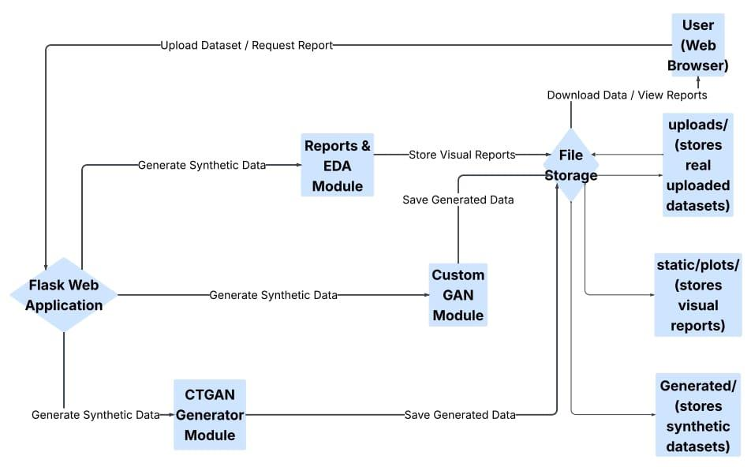
SYSTEM ARCHITECTURE

Slide 13
SYSTEM SPECIFICATION
SOFTWARE REQUIREMENTS:
OS: Windows 10/11 (64-bit), macOS 10.14 (Mojave) or later, Linux with GNU C Library (glibc) 2.31 or later
IDLE: Python web
Software: Compatible web browsers (e.g., Chrome, Firefox, Safari)
Additional: Internet connectivity, GPS module for location services, IoT device compatibility for sensor integration

Slide 14
SYSTEM SPECFIFICATION
HARDWARE REQUIREMENTS:
RAM: Minimum 8 GB RAM, recommended 16 GB RAM
Processor: Dual core Processor
Disk Space: Minimum 10 GB, recommended 20 GB (excluding system and project files)
Screen Resolution: Minimum 1366 x 768

Slide 15
MODULES
Data Collection & Preprocessing
GAN-Based Synthetic Data Generation
Statistical Evaluation of Synthetic Data
ML Model Training with Synthetic Data
Bias & Privacy Analysis
Computational Optimization & Deployment

Slide 16
Module 1.Data Collection & Preprocessing:
Dataset Upload: Users can upload any structured dataset (CSV format) through a web interface.
Initial Inspection: Basic metadata (column types, null values, unique counts) is extracted and displayed.
Data Cleaning: Handles missing values, removes duplicates, and deals with outliers if required.
Encoding: Categorical features are label/one-hot encoded based on their nature and GAN requirements.

Slide 17
Module 1.Data Collection & Preprocessing:
Scaling: Numerical features are normalized or standardized to aid GAN model convergence.
Type Detection: Automatically detects column data types to guide model input formatting.
EDA Report: Generates automated EDA visualizations (histograms, correlations, value counts) pre-generation.
Flexible Schema Handling: Designed to generalize preprocessing for any dataset structure..

Slide 18
Module 2.GAN-Based Synthetic Data Generation
Model Selection: Supports both CTGAN and a custom PyTorch-based GAN architecture.
Training Pipeline: Trains GANs on preprocessed data, learning feature distributions.
Noise Vector Input: Uses random noise input to generate new synthetic samples.
Mixed Data Handling: Properly handles mixed types (categorical + continuous) using embedding layers.

Slide 19
Module 2.GAN-Based Synthetic Data Generation
Hyperparameter Tuning: Allows configuration of epochs, batch size, learning rate, etc.
Synthetic Output Format: Outputs synthetic data in the same schema as the real data.
Training Feedback: Displays loss curves (Generator & Discriminator) during training.
Data Storage: Saves generated synthetic datasets for download and evaluation.

Slide 20
Module 3.Statistical Evaluation of Synthetic Data:
Distribution Comparison: Uses histograms, KDE plots, and boxplots to compare real vs synthetic distributions.
Correlation Analysis: Visualizes correlation matrices to compare relational structures.
Statistical Metrics: Includes metrics like KS-test, JS divergence, and Chi-square for similarity checks.
Dimensionality Reduction: Uses PCA or UMAP to visualize real vs synthetic data in reduced dimensions.

Slide 21
Module 3.Statistical Evaluation of Synthetic Data:
Summary Statistics: Compares means, variances, min, max, and standard deviation of each feature.
Data Utility Report: Evaluates fidelity and diversity scores of synthetic data.
Quality Score Dashboard: Displays visual scores (0–1 range) indicating synthetic data quality.
Exportable Evaluation Report: Generates a downloadable PDF report of all statistical evaluations.

Slide 22
Module 4.ML Model Training with Synthetic Data:
Model Setup: Supports models like Logistic Regression, Random Forest, and SVM.
Train/Test Frameworks: Allows training on synthetic and testing on real (and vice versa).
Cross-validation: Performs k-fold validation to measure model robustness.
Performance Metrics: Uses accuracy, precision, recall, F1-score, ROC-AUC for evaluation.

Slide 23
Module 4.ML Model Training with Synthetic Data:
Visual Comparison: Provides bar charts or confusion matrices comparing model performance.
Overfitting Check: Measures how well synthetic data generalizes compared to real data.
Model Persistence: Saves trained models and evaluation results for later use.
Synthetic Data Utility: Indicates how suitable synthetic data is for real-world ML tasks.

Slide 24
Module 5.Bias & Privacy Analysis:
Bias Detection: Checks for demographic bias using fairness metrics (e.g., disparate impact, equal opportunity).
Privacy Leakage Testing: Tests for potential information leakage via Membership Inference Attacks.
Sensitive Feature Tracking: Highlights bias or data drift in protected attributes (e.g., gender, race)
Similarity Metrics: Measures how close synthetic data points are to real records (DCR, nearest neighbor).

Slide 25
Module 5.Bias & Privacy Analysis:
Fairness Dashboard: Visual representation of fairness across different subgroups.
Anonymity Score: Computes a score representing identity disclosure risk.
User Warnings: Flags columns or data points that violate privacy or fairness thresholds.
Documentation: Logs and documents ethical considerations and audit trails for compliance.

Slide 26
Module 6.Computational Optimization & Deployment
Training Optimization: Use early stopping, mini-batch training, and checkpointing for efficient GAN training.
Hardware Acceleration: Detect and utilize available GPUs or fallback to CPU for computation.
Caching Mechanisms: Implement caching to avoid redundant computations and speed up performance.
Web UI Integration: Deploy an interactive Flask-based web interface for user-friendly access.

Slide 27
Module 6.Computational Optimization & Deployment
Downloadable Outputs: Enable one-click downloads of synthetic data, visualizations, and reports.
Memory & Session Management: Manage resources by clearing sessions and handling multiple user instances.
Responsive UI/UX: Ensure a clean, elegant, and mobile-friendly design for all screens.
Cloud Deployment: Support scalable deployment using services like Render, AWS, or Docker with Gunicorn.

Slide 28
ADVANTAGES
Enhances Model Robustness – Synthetic data improves generalization and reduces overfitting.
Addresses Privacy Concerns – Enables data sharing without exposing sensitive information.
Overcomes Data Scarcity – Generates diverse datasets for better model training.
Improves Data Augmentation – Expands training datasets for better performance in ML models.
Enables Fairer AI Models – Helps balance class distributions and mitigate bias.

Slide 29
APPLICATIONS
Healthcare – Generates synthetic patient records while preserving privacy.
Finance – Creates realistic transaction data for fraud detection models.
Autonomous Vehicles – Simulates driving scenarios to train self-driving AI.
Cybersecurity – Produces attack and normal behavior data for intrusion detection.
Retail & E-commerce – Synthesizes customer data to improve recommendation systems.

Slide 30
CONCLUSION
GAN-generated synthetic data is a valuable tool for ML model training.
Enhances model robustness, addresses privacy concerns, and overcomes data scarcity issues.
Future work includes improving GAN architectures for better data fidelity and applying this approach in real-world AI applications.
This project demonstrates how synthetic data can be a game-changer in AI and ML model training.

Slide 31
REFERENCES
Goodman, T., & Lee, R. (2019). Enhancing Machine Learning with Synthetic Data: Challenges and Opportunities. Journal of Artificial Intelligence Research, 45(3), 112-130. Available: https://www.jair.org/synthetic-ml-data. Last accessed 18th March 2024. This paper explores the role of synthetic data in improving machine learning model performance, addressing challenges like data scarcity and bias.
Chen, Y., Patel, S., & Wang, H. (2018). Generative Adversarial Networks for Data Augmentation in Healthcare. International Conference on Machine Learning Applications, 12(4), 221-234. Available: https://www.icmla.org/gan-healthcare. Last accessed 10th February 2024. This study investigates the use of GANs for generating synthetic healthcare data while maintaining patient privacy and data integrity.
Davenport, M., & Zhang, Q. (2019). Evaluating the Effectiveness of Synthetic Data in Financial Risk Modeling. Financial Data Science Journal, 7(2), 89-104. Available: https://www.fdsj.org/synthetic-finance. Last accessed 5th January 2024. This research analyzes the application of synthetic financial data for fraud detection and credit risk assessment.

Slide 32
THANK YOU

